Slide 1

HOSTEL MANAGEMENT SYSTEM
Department of computer science and Engineering
SRM UNIVERSITY, AP
A. Yaswanth - AP20110010661
K. Likitha Sri - AP20110010655
K. Kavya Keerthana - AP20110010668
E. Srikanth - AP20110010683

Slide 2
INTRODUCTION
The Hostel Management System is a user-friendly programme that makes hostel management easier. It automates operations like student check-ins, room allocations, and billing, making administrative work easier for hostel personnel. This system also includes a centralised database for storing student data and payment records, allowing for easy access and organisation. The Hostel Management System is a vital tool for efficient hostel management due to its user-friendly interface.
PURPOSE:
The purpose of a hostel management system software is to automate and streamline the administrative tasks involved in managing a hostel, including registration of guests, room allocation, fee management, attendance tracking, and other related tasks. Hostel management system software can reduce the amount of time and help maintain accurate records of guest details and help maintain a secure and safe environment.

Slide 3
Intended Audiences:
This application is primarily meant for all project developers affiliated with this project. The specification is divided into numerous sections or members that can be read and referred to as follows.
project manager - to manage all the processes in the project
software designer - design the models and diagrams that help the programmer in the implementation phase
software tester - to test the system by using dummy data
database administrator-to perform database operations
software analyst - to analyze the requirements of the hostel management system
Additional Audiences:
Students who are planning to stay in a hostel.

Slide 4
EXISTING SYSTEM
The software typically includes modules for guest management, room management, reservation management, billing and payment processing, inventory management, staff management, reporting and analytics, and security and access control. These modules work together to provide a seamless and efficient experience for both staff and guests.
• Room management features enable staff to create and manage room types, room allocation, and room availability status.
• Billing and payment management features enable staff to manage billing and payment processing for room charges, additional services, and other fees.
• Staff management features enable staff to manage staff details, attendance tracking and roles and responsibilities.
• Security and access control features provide security such as access control, user authentication, and backup and recovery options.

Slide 5
SYSTEM REQUIREMENTS
FUNCTIONAL REQUIREMENTS:
Student Management:
=>Student registration and profile creation
=>Capture and storage of student information (e.g.,name,contact details, identification documents).
Hostel Booking:
Online hostel booking system for students to book rooms in advance. Managing changes to reservations, including modifications, cancellations, and refunds.
Room and Bed allocation:
Room allocation based on student preferences, such as room type, bed size, and amenities. Efficient management of room inventory and availability. Tracking of bed occupancy within each room. Ability to accommodate group bookings or assign adjacent rooms. Handling special requests(handicapped) or room transfers.
Billing and Payment:
Automated generation of invoices for room charges, additional services, and taxes. Support for different payment methods (cash, credit card, online payment).

Slide 6
NON FUNCTIONAL REQUIREMENTS:
Performance requirements
The application shall be based on HTML, CSS, Java script, PHP, and SQL. It can be executed on any platform. The performance may depend on the hardware and software components of the system, the application is executed.
Safety Requirements
The database may get crashed in case of any operating system failure or malicious program attack. Maintaining backup is highly recommended.
Security Requirements
The application software uses an efficient access control protocol to avoid unauthorized access to the database.
Software quality attributes
-Reliability and Availability: The project handles the data with SQL database
-Maintainability: The system is capable of backing up the data at regular intervals.
-Portability: The HMS needs a computer with Microsoft OS.
The software is resilient and fault tolerant to achieve availability. It is interoperable because of the automated report sent to the developer for solving the issue later on.

Slide 7
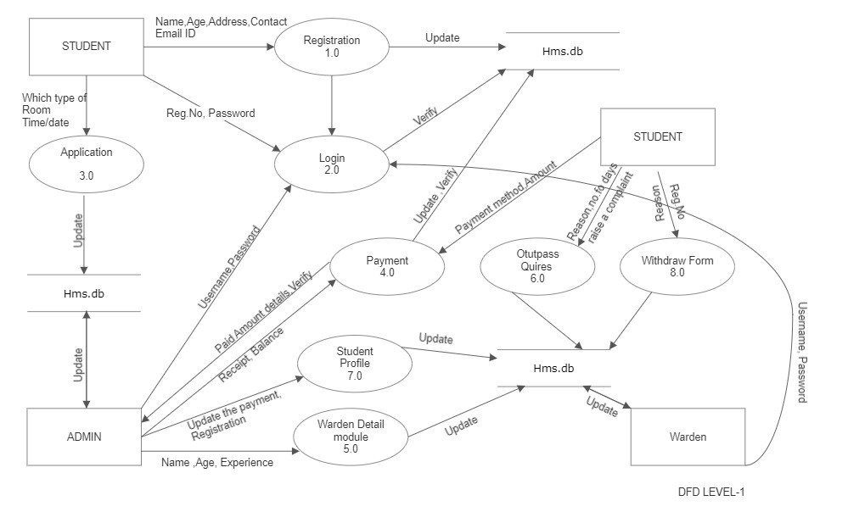
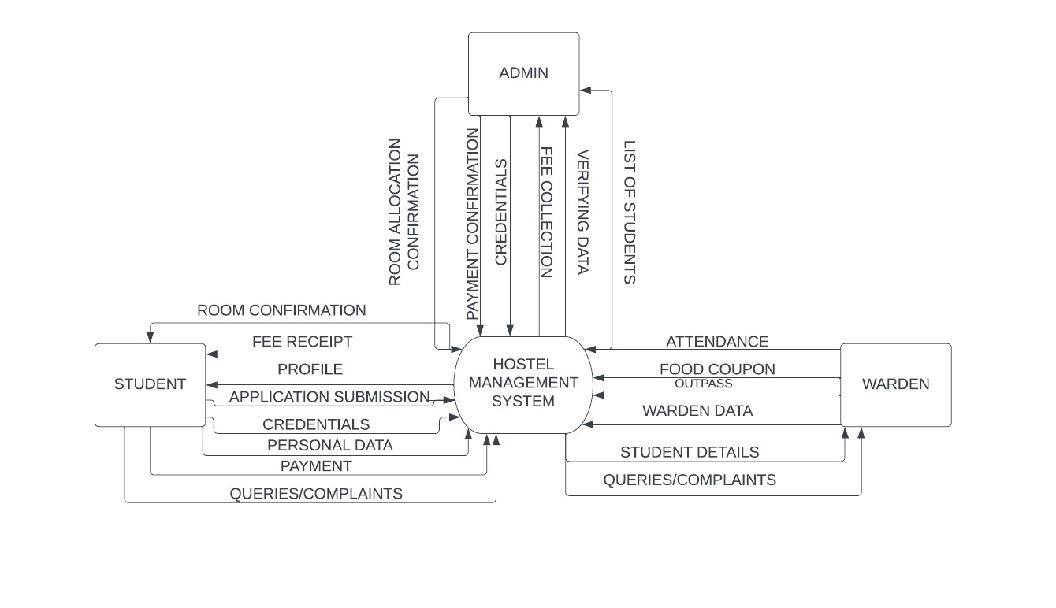
PROPOSED SYSTEM
Data Flow Diagram
CONTEXT LEVEL-0 DFD
CONTEXT LEVEL-1 DFD

Slide 8
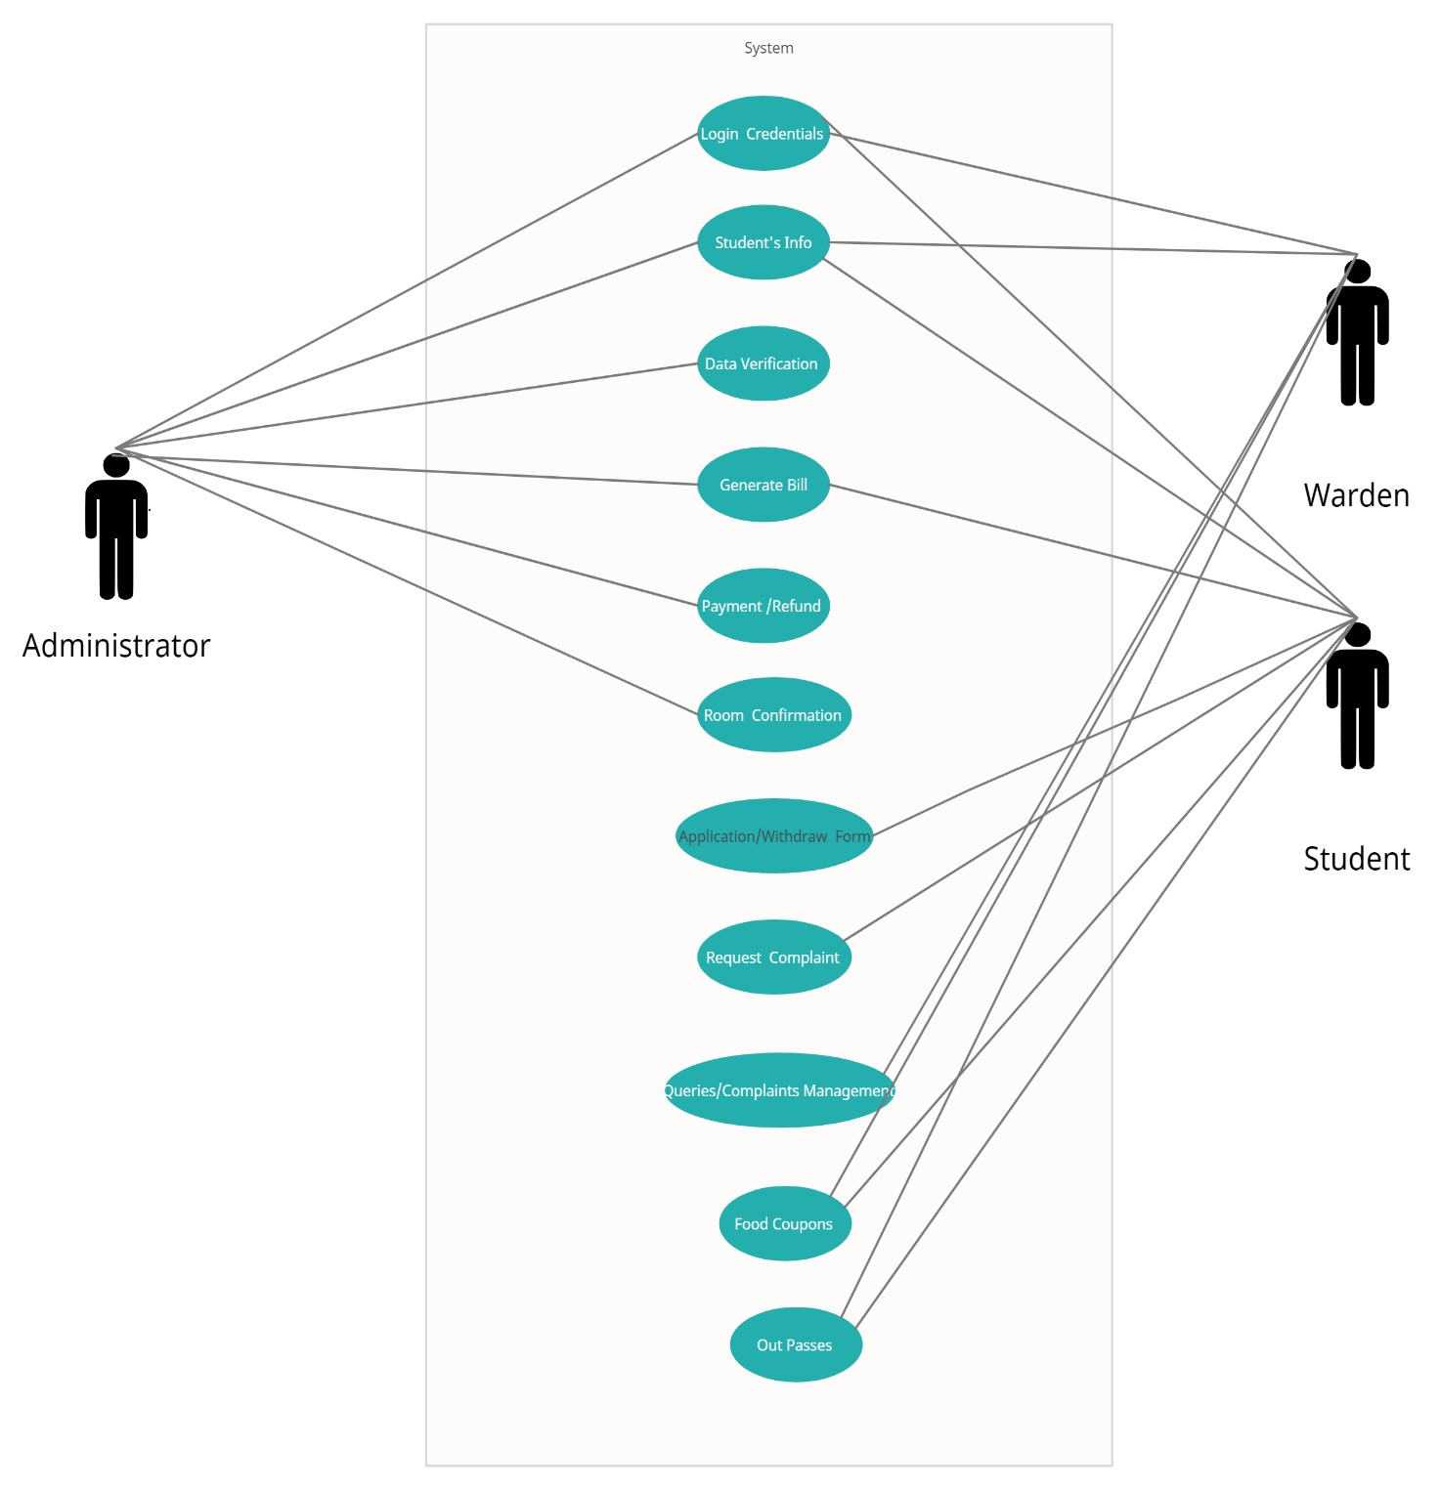
USE CASE DIAGRAM

Slide 9
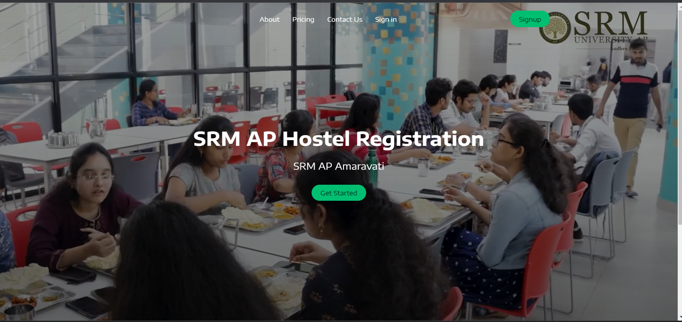
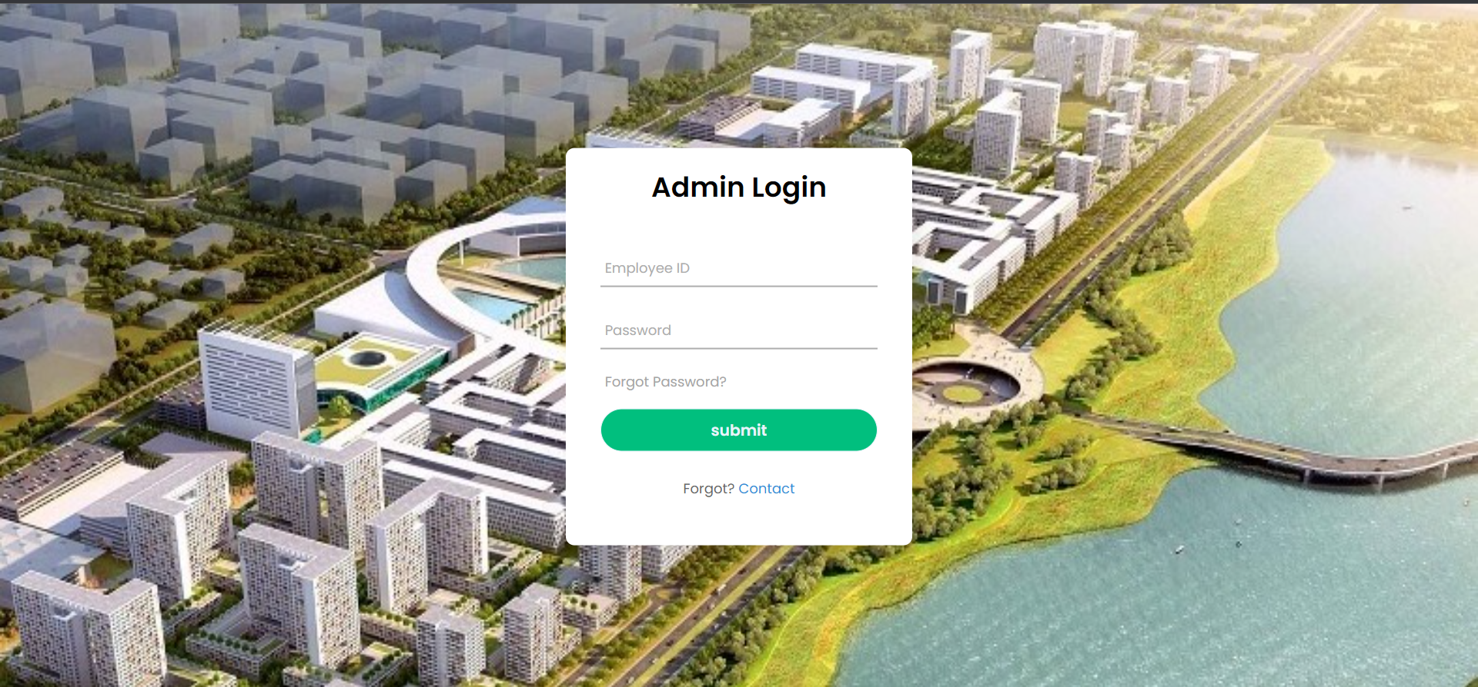
RESULTS

Slide 10
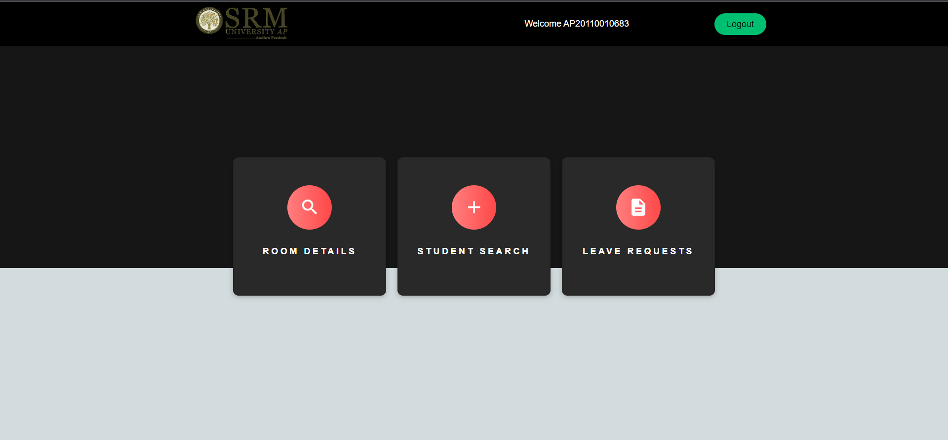
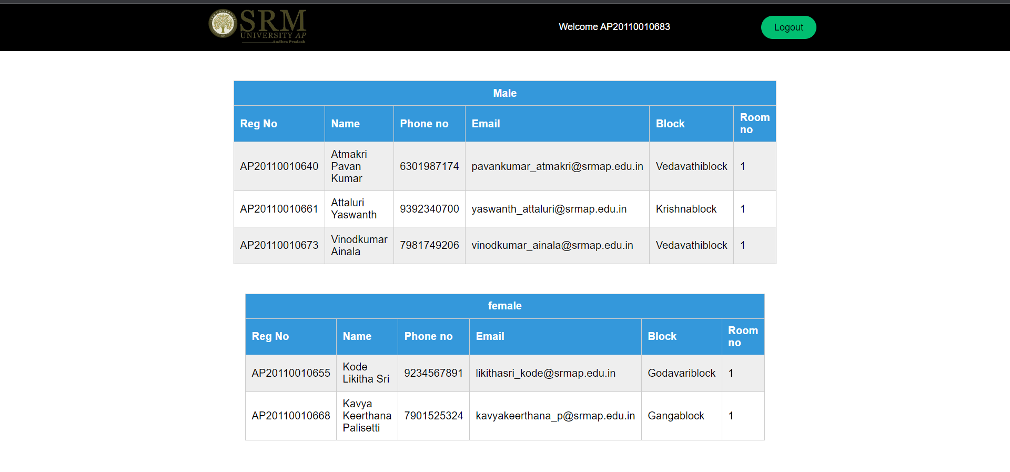

Slide 11
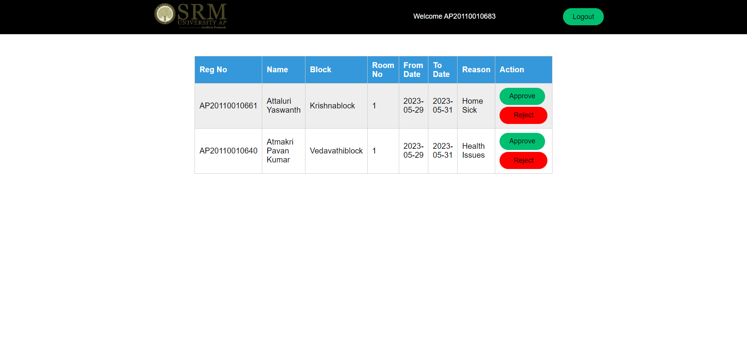
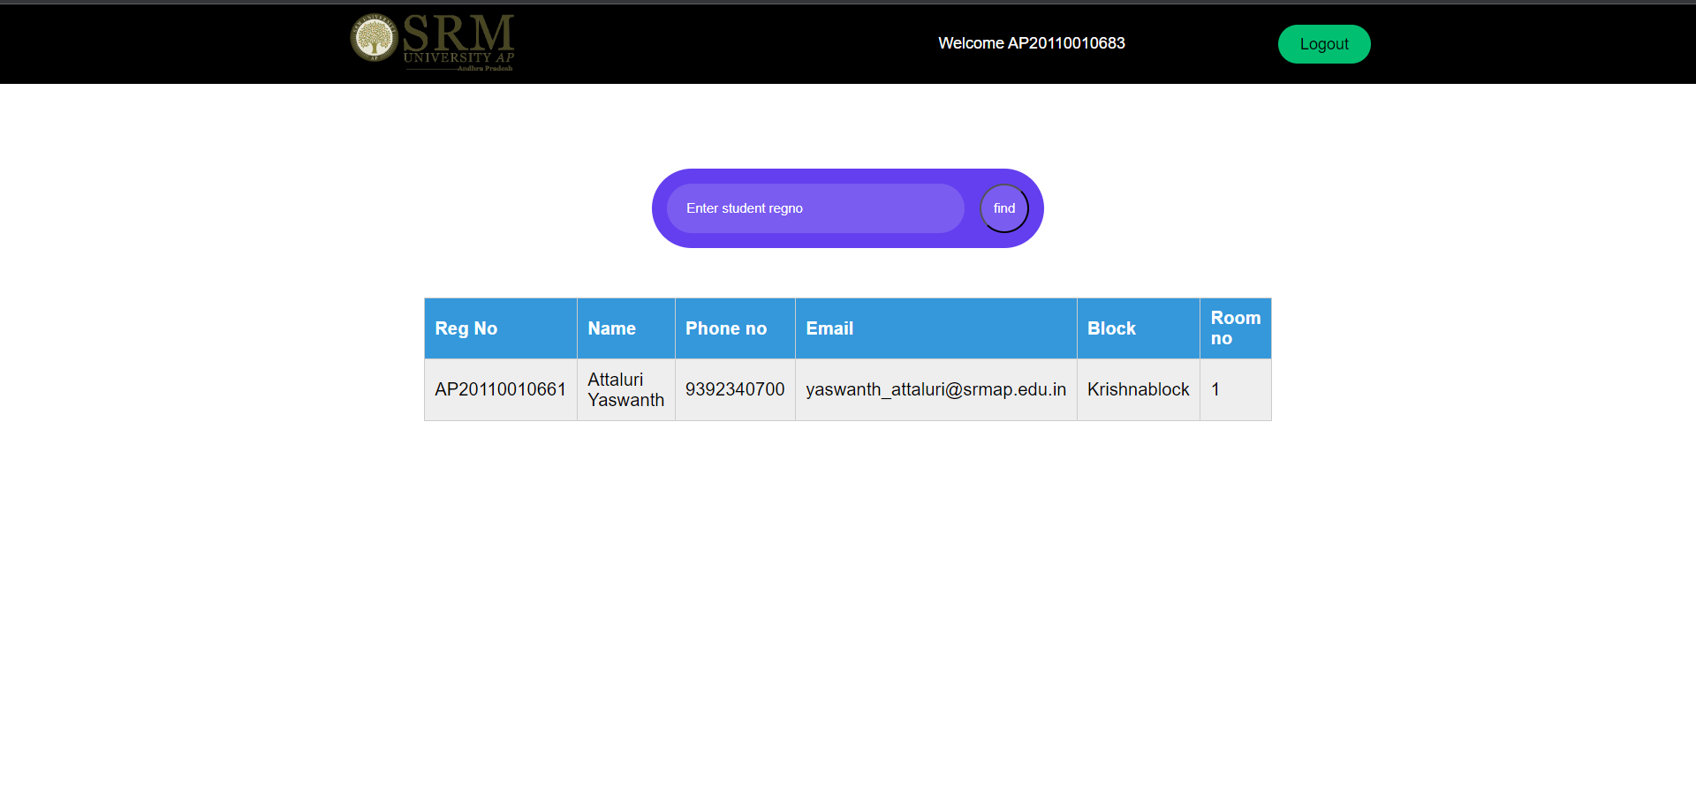

Slide 12
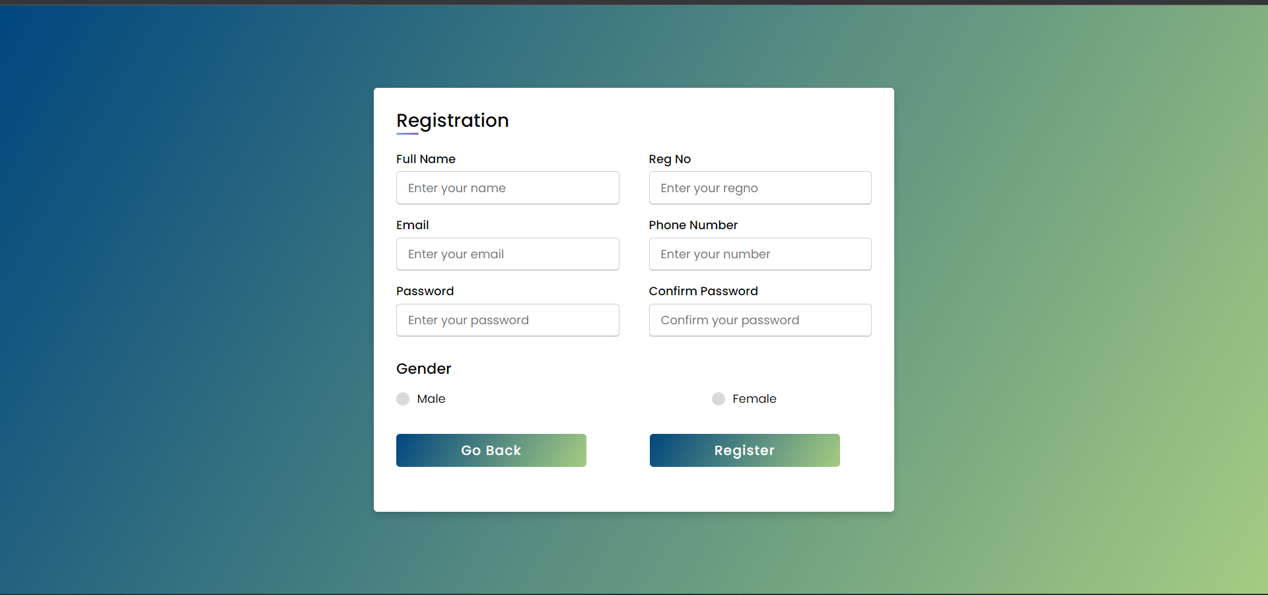
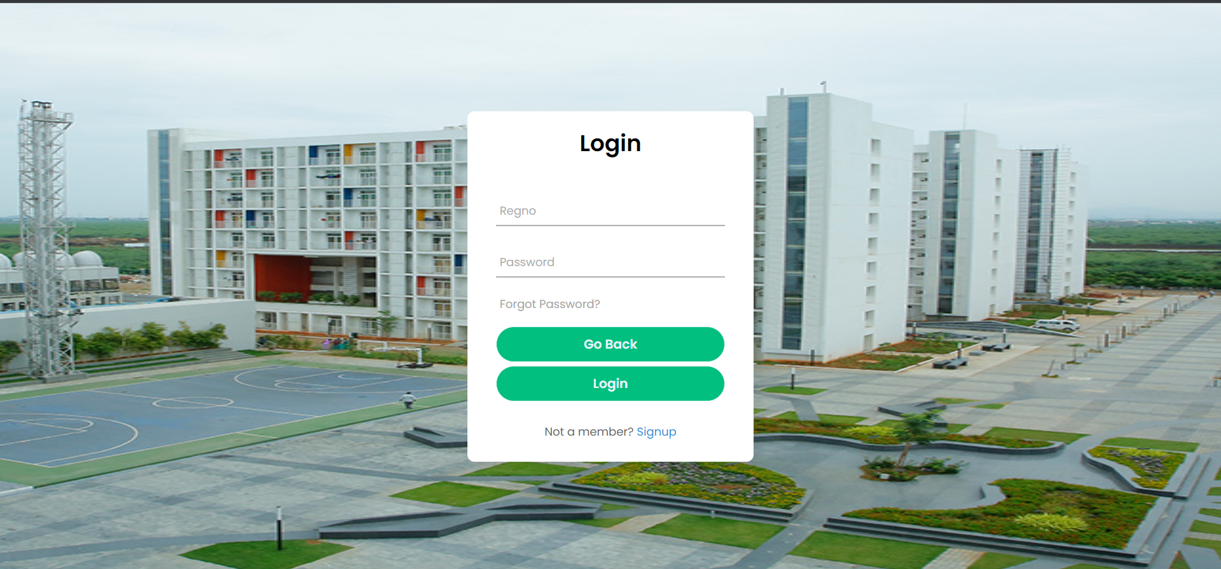

Slide 13
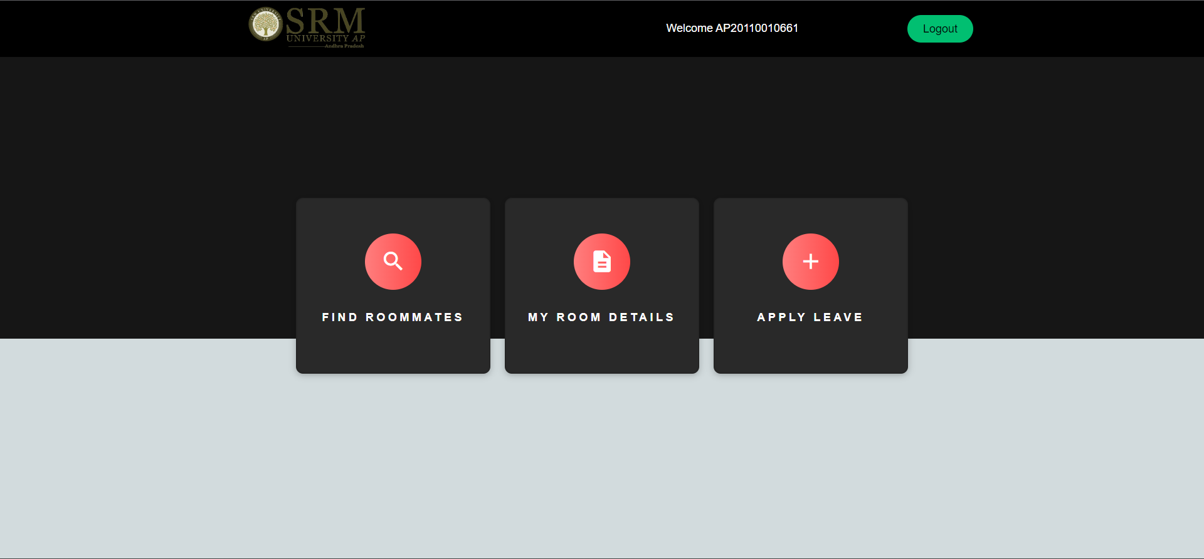

Slide 14
CONCLUSION
The project is based on the user's requirement specification and an analysis of the existing system, with flexibility for future extension.
The increased functionality of today's software necessitates a more systematic approach to software development. This hostel management software is for those who want to keep track of a variety of activities in the hostel. The number of educational institutions has been significantly expanding in recent years. As a result, the number of hostels available for students studying at this university is expanding. As a result, the person in charge of the hostel is under a lot of stress, and software is rarely employed in this situation.This solution addresses the challenges of running a hostel and avoids the issues that arise when done manually.
The identification of the existing system's flaws leads to the creation of a computerised system that is compatible with the existing system while being more user friendly and GUI oriented.

Slide 15
REFERENCE
https://www.ijraset.com/research-paper/hostel-management-system-hms
https://sourceforge.net/projects/hostel-management-system/
https://www.codementor.io/projects/hostel-management-system-atx32n08vq
https://www.php.net/manual/en/index.php
https://www.php.net/manual/en/getting-started.php
https://www.youtube.com/playlist?list=PL4cUxeGkcC9gksOX3Kd9KPo-O68ncT05o

